Slide 1
Le repaire d’Amélia
Amélia’s lair

Slide 2
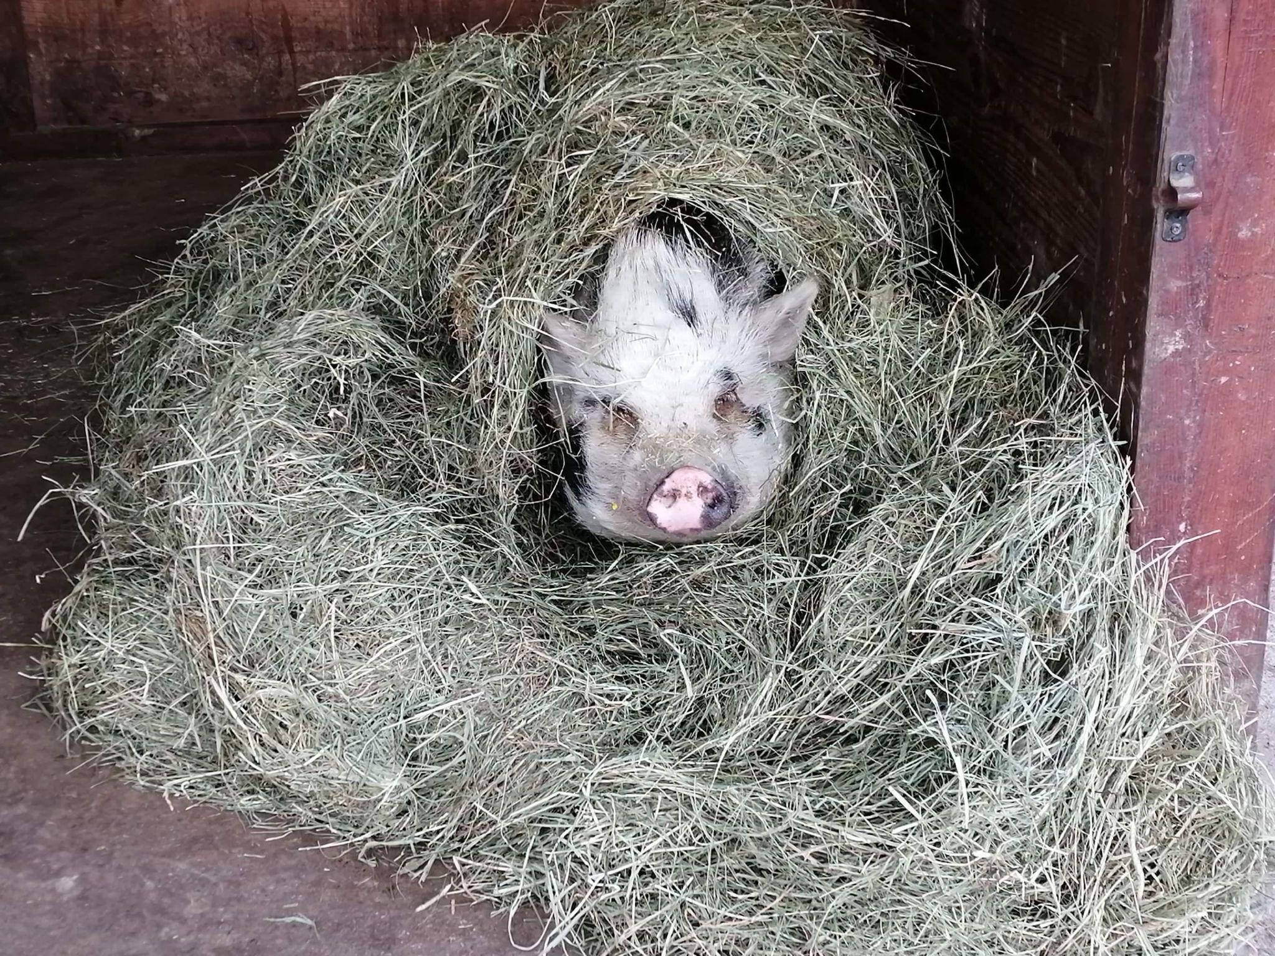
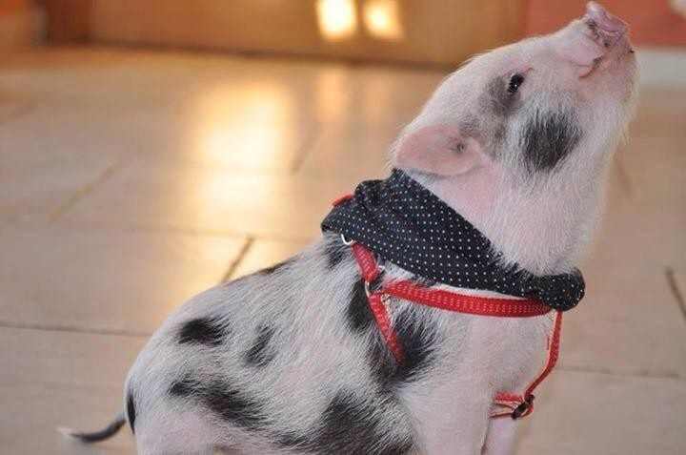
Who is Amélia?

Slide 3
Ikigai
What I love
What I am good at
Growing fruits and vegetables
Nature
Plants
Having a meaningful job
Manual labor
Working with plants
Manual labor
What I can be paid for
What the world needs
Selling fruits and vegetables
Workshops
Healthy and sustainable products
Engaged companies

Slide 4
What do I offer ? (value)
What
Client’s need
How I stand out
Fruits and vegetables cultivated in permaculture
Workshops
Quality food
Contributing to a more sustainable economy
Quality products
Help for people with psychological problems

Slide 5
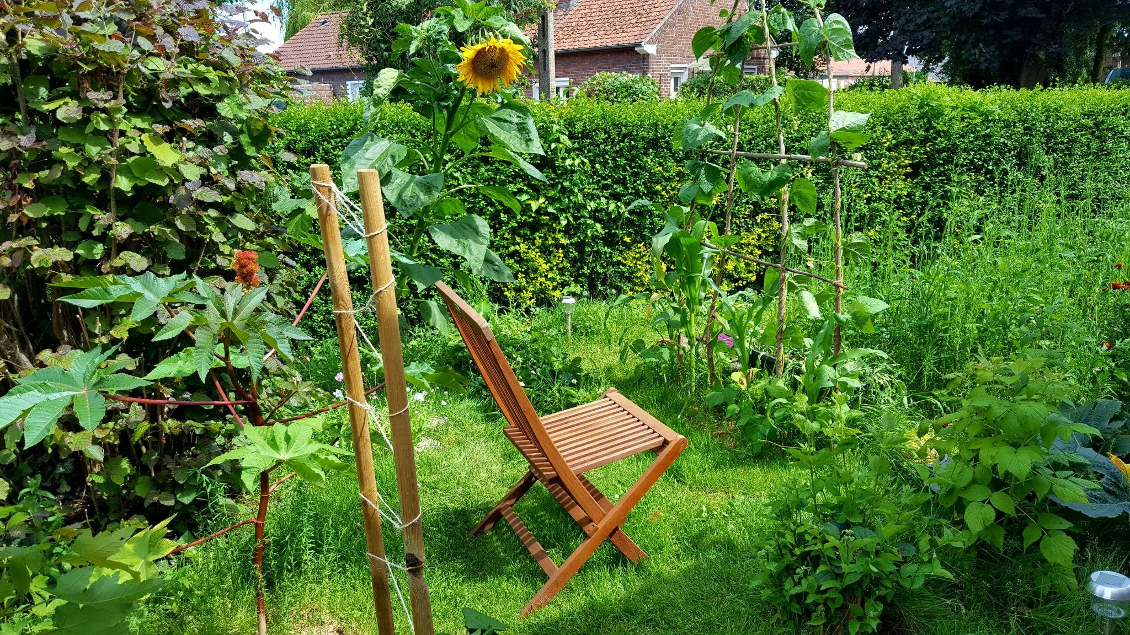
What is permaculture?
"Permaculture is originally a concept of sustainable agriculture and horticulture based on the careful observation of ecosystems and natural cycles and their imitation.“
It was developed in the 1970s by Australian biologist Bill Molisson.
Associating crops (ex Milpa)
Animals
Use of fences
Ponds
Etc

Slide 6
Who are my target customers?
Age
Hobbies
Nature Cooking
Environment
25-60 years-old
Occupation
Gender
All careers
No gender
Location
Social class
Close to farms
In the city for companies
With some purchasing power

Slide 7
Who are my target companies?
Committed for a more sustainable society
In the city
In tune with the times
With some purchasing power

Slide 8
Customer relations
How to find my first client? And the following ones?
Social media
Organic stores (posters)
Crowdfunding
Canvassing (companies)
Youtube channel and collaboration
Building customer loyalty?
Subscription system
Organizing events
Recipes in basket

Slide 9
Contact
Where
When
Store at the small farm
Order online or buy in bulk on site
Easy acces and parking spots
Delivery for companies
3 times per week from 3pm to 6pm à
Once a week

Slide 10
Example of rental location

Slide 11
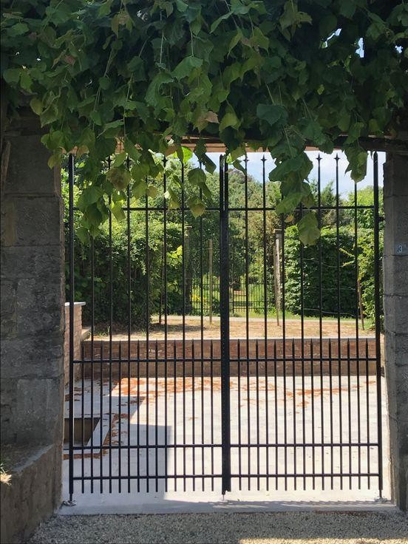
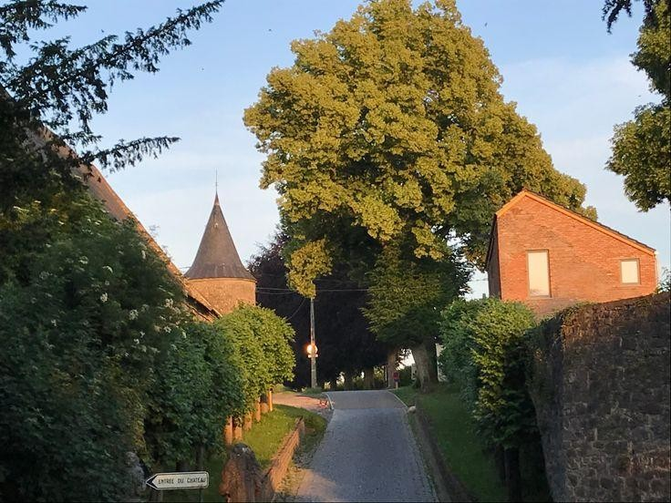

Slide 12
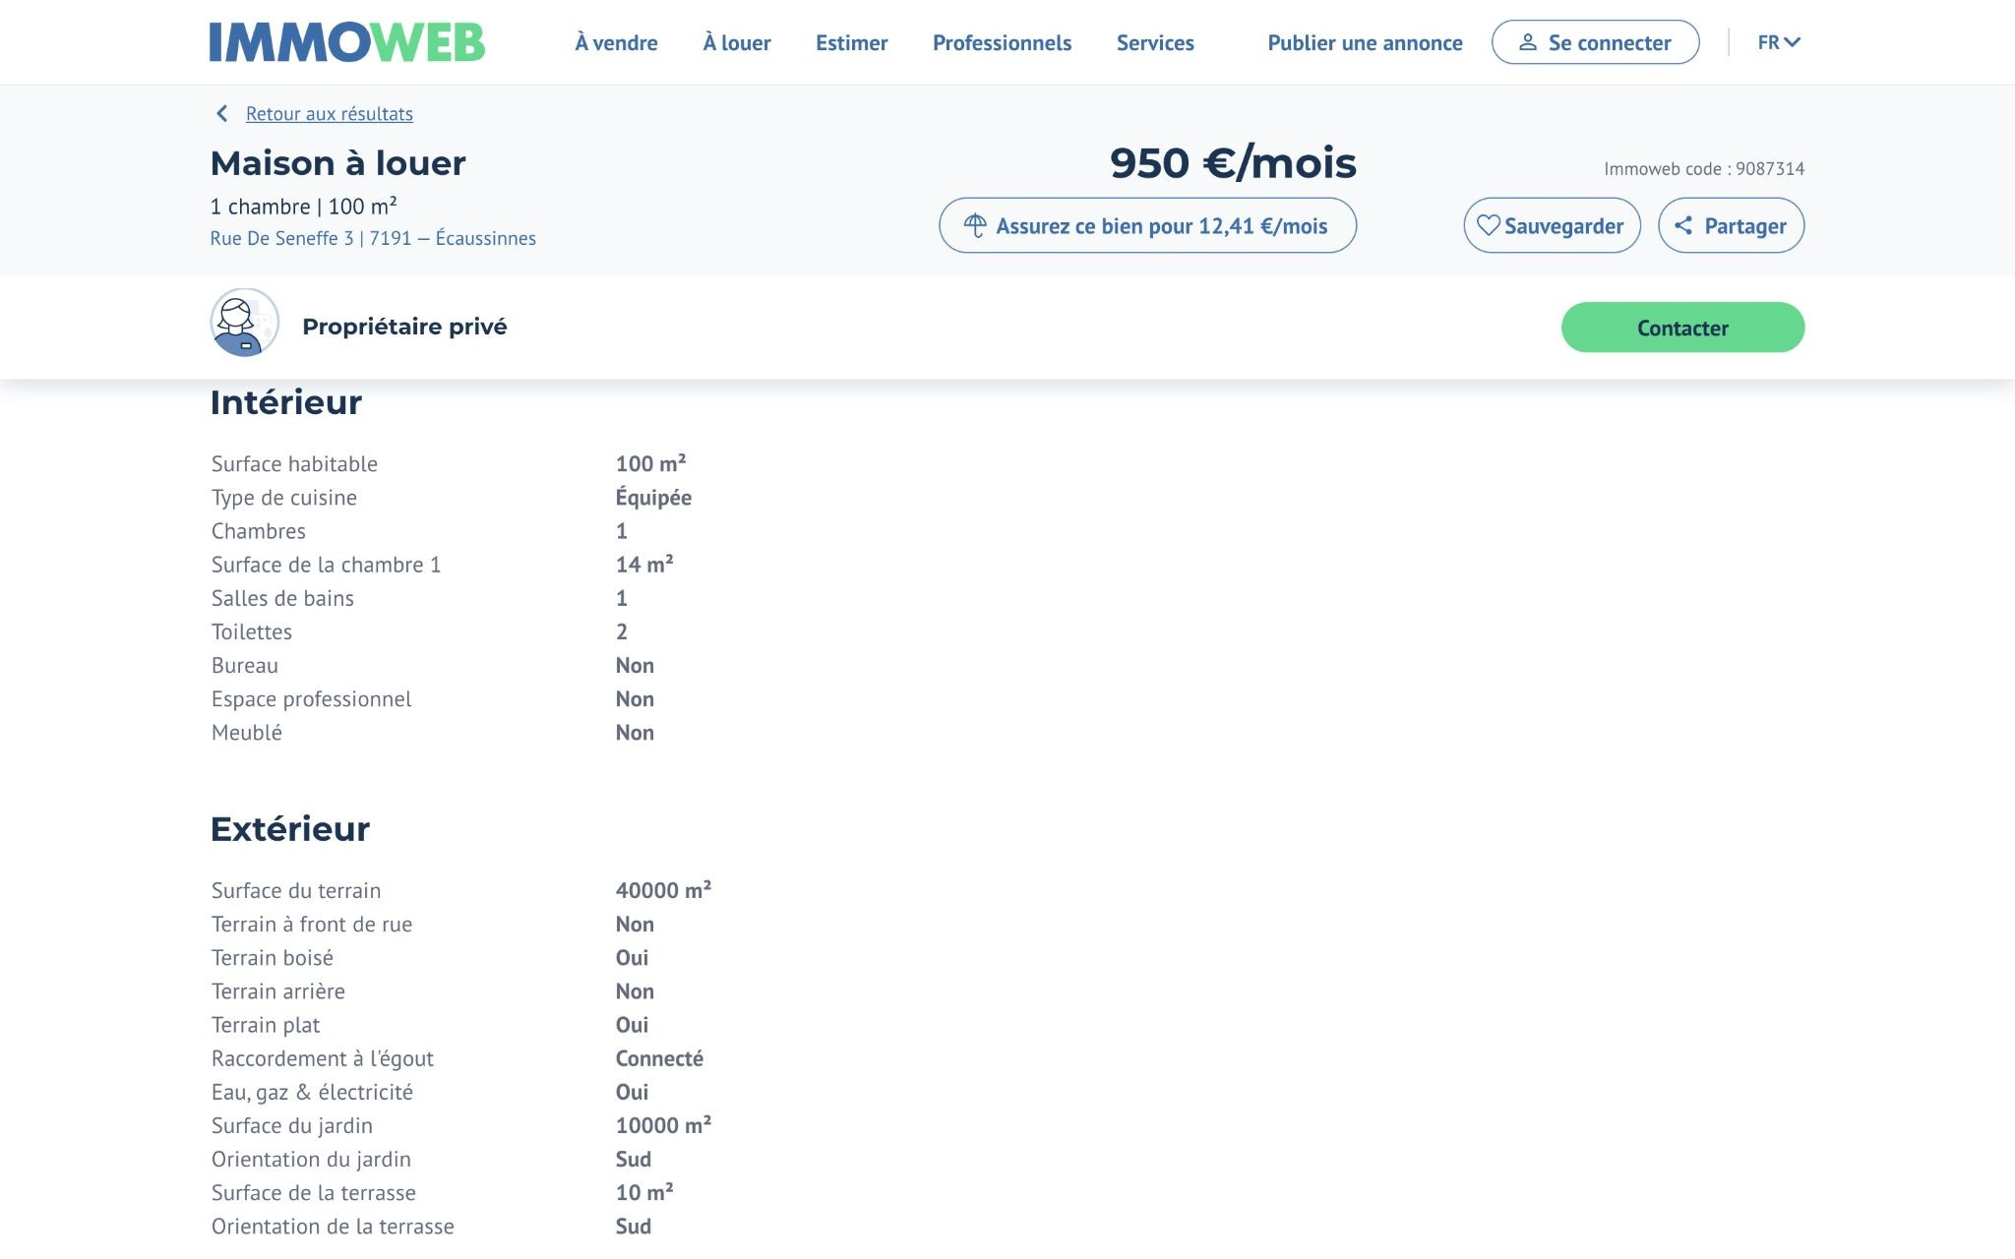

Slide 13
Rates
Subscription
Average fare
Workshop
125€/month
40€/unit
50€/2h

Slide 14
Key activities
Farming
Planning
Soil preparation
Sowing
Planting
Watering
Harvesting
Others
Administrative work
Workshop preparation
Planning for seasonal worker
Managing volunteers
Preparation of baskets
Preparation of the store
Delivery for companies

Slide 15
Partners/suppliers
Non-profit organization working in mental health
Association of market gardeners
Organic seeds and saplings
Fruit and vegetables if required
Potting soil for seedlings
Amendments and fertilizers
Irrigation
Tools
Partners
Suppliers

Slide 16
Ressources
Staff ?
Authorization ?
1 seasonal student worker
Volunteers (therapy)
AFSCA
Access to regulated profession?
Finances ?
Material ?
Yes Crowdfunding
Greenhouse Tarpaulin
Micro tractor Irrigation
Tools
No

Slide 17
Competition
Direct
Indirect
Supermarkets
Other market gardeners
Local markets
Home garden

Slide 18
Monthly sales revenue
Total sales revenue : 6.525 € Purchase costs: 1631 € (25%)
Subscription
Average basket
Workshop
125 €
25/month
Total = 3125 €
40 €
25/day
3/week
Total = 3000 €
50 €/person
8 people/week
1/week
Total = 400 €

Slide 19
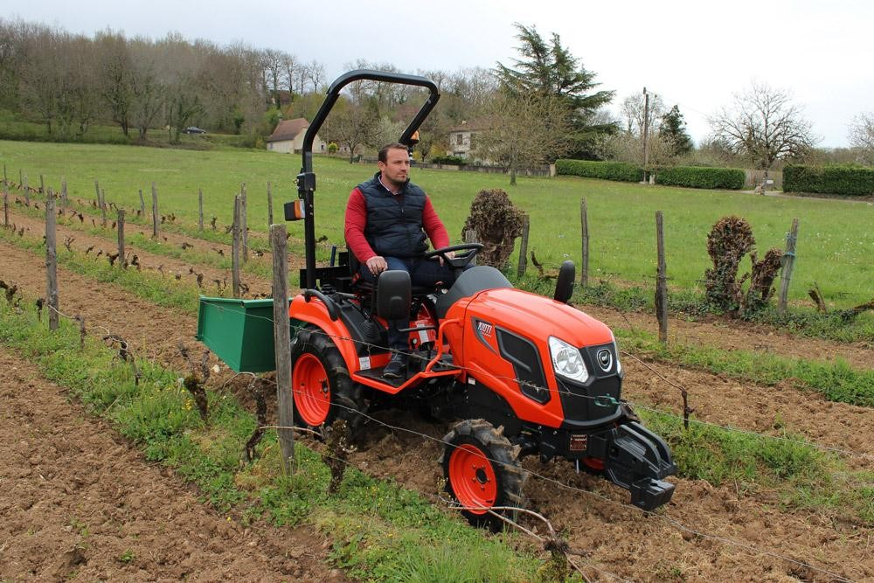
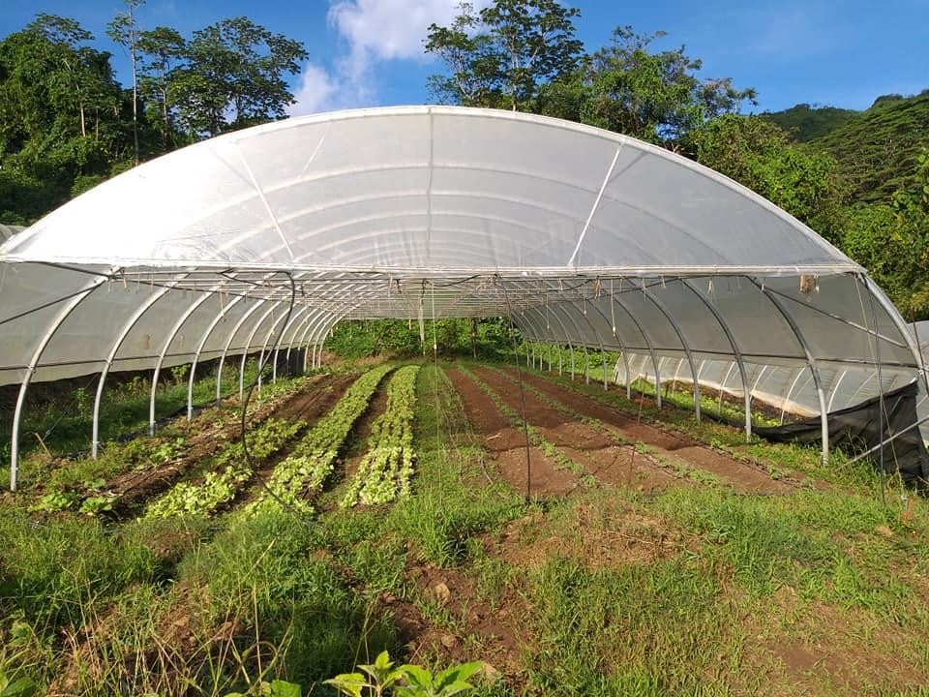
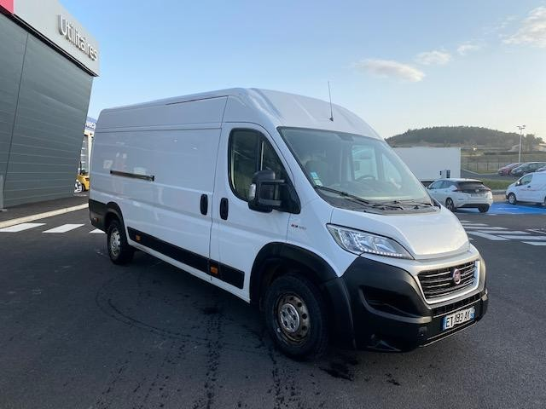
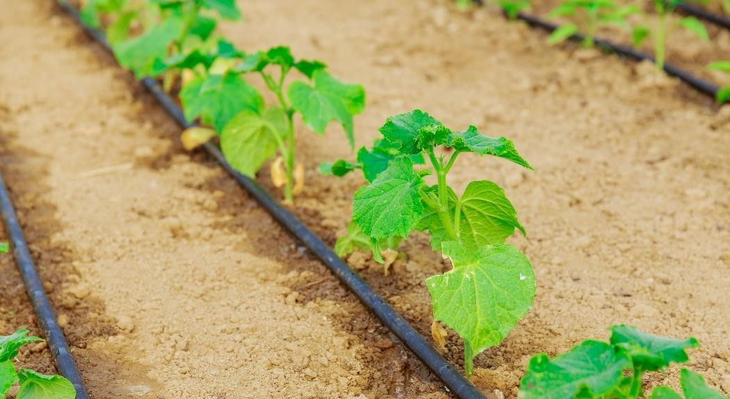
Investments
Total investments : 37 000 €

Slide 20
Operating expenses
Operating expenses
Payroll | €2,640
Rent | €500
Telecom | €70
Insurances | €120
Energy | €150
Advertisement | €50
Transports | €210
Interests | €141
Various expenses | €250
Total | 4,131

Slide 21
Financing
Capital required | €48,394
Personal contribution | €14,518 | 30%
Amount to be borrowed (crédal) | €33,875
Payment period (years) | 10
Payment period (months) | 120
Capital rapayment / month | €282
Annual interests | €1,694 | 5%
1st interest | €141

Slide 22
 | Cash | Tax
Sales revenue | 6,525 € | 6,525 €
- Purchase costs | 1,631 € | 1,631 €
Gross profit | 4,894 € | 4,894 €
- Operating expenses | 4,131 € | 4,131 €
Operating income | 763 € | 763 €
- Amortization |  | 600 €
Profit before tax |  | 163 €
- Tax | 49 € | 49 € | 30%
Net income | 714 €
- Credit repayment | 282 €
Available earnings | 432 €
Calculation of profit

Slide 23
Analyse SWOT
Strengths
Weaknesses
Knowledge Commitment Motivation
Personal organizational skills/efficiency Contact with clients
Opportunities
Threats
A booming market
Useful to society
Not properly remunerated
Weather and natural disasters (climate change)
Competition from larger farmers or organic chain stores (e.g. bioplanet)

Slide 24
Development opportunities
Processed products
Organic store sales
Market
Market gardening training
Educational farm
Garden tours
Event organization
Garden and nature therapy
Video on the farm
etc

Slide 25
People Planet Profit
A caring environment and a meaningful job for my employees, a therapeutic place for volunteers, fair prices
Commitment to ecology with permaculture food production, no pesticides, as little packaging as possible, no chemical fertilizers, too good to go, biological control, second-hand equipment
Investment in associative projects, helping other market gardeners to set up

Slide 26
Thanks for your attention :)
CREDITS: This presentation template was created by Slidesgo, and includes icons by Flaticon, and infographics and images by Freepik

